Slide 1
Morphology and vocab
We are learning to use morphemes to predict the meanings of words

Slide 2
Which of the following words do you recognise?
Predicted
unpredictable
Dictionary
Dictator
contradictory

Slide 3
What do you notice when we break the words up in this way?
pre - dict - ed
un - pre - dict - able
dict - ion - ary
dict - at - or
contra - dict - ory

Slide 4
English words are made of parts that have meaning. These are called morphemes.
Some morphemes can be words by themselves like “foot”, and maybe combined with other words morphemes like “path” or “ball” to make:
footpath
football
footy
footing

Slide 5
The following word has four morphemes. Which do you recognise?
un - pre - dict - able
not
before
can/possible
say
“Not something you can say before it happens”

Slide 6
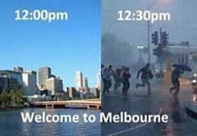
un - pre - dict - able
不可预测的
不可預測的
不可預測嘅
غير متوقع
khó đoán
പ്രതീക്ഷിക്കാനാവാത്ത غیرقابل پیش‌بینی غیر
قابل پیش‌بینی
予測できない ሊገመት የማይችል imprevizibil
نه وړاندوینه کېدونکی ناقابلِ پیش گوئی
“Weather in Melbourne is unpredictable”

Slide 7
prefixes | meaning | translated | Roots | English meaning | translated | Suffixes | English meaning | translated
contra | against | 反/反/ضد/chống/എതിര്‍/ضد/反/ተቃውሞ/contra/پر ضد/خلاف | dict | say / speak | 說/说/يقول/nói/പറയുക/گفتن/言う/መናገር/a spune/ویل/کہنا | able | can be | 能夠/能够/قابل/có thể/കഴിയുന്ന/قابل/できる/የሚችል/capabil/کېدونکی/قابل
pre | before | 在前/在前/قبل/trước/മുൻ/پیش/前/በፊት/înainte/مخکې/پہلے |  |  |  | ary | related to / place for | 相關的/相关的/متعلق بـ/liên quan/ബന്ധപ്പെട്ട/مربوط/〜の/የተያያዘ/legat de/اړوند/متعلق
un | not | 不/不/غير/không/അല്ല/نـ/不/አይ/nu/ne/نہ |  |  |  | ate | make / cause to become | 使/使/يجعل/làm cho/ആക്കുക/کردن/〜にする/ማድረግ/a face/کول/بنانا
 |  |  |  |  |  | ed | past tense | 過去/过去/الماضي/đã/കഴിഞ്ഞ/گذشته/過去/ያለፈ/timp trecut/تېر/گزشتہ
 |  |  |  |  |  | ion | act / process | 行為/行为/عملية/sự/പ്രക്രിയ/عمل/こと/ሂደት/proces/بهیر/عمل
 |  |  |  |  |  | or | person who | 人/人/شخص/người/ആള്‍/کننده/人/ሰው/persoană/کوونکی/کرنے والا
 |  |  |  |  |  | ory | relating to | 關於/关于/متعلق/thuộc về/ബന്ധപ്പെട്ട/مربوط/〜に関する/የሚመለከት/referitor la/اړوند/متعلق
Notes:
Open your Vocab book and look at the first 3 examples. Add the translation from your language to the word predicted and the write an example sentence

Slide 8
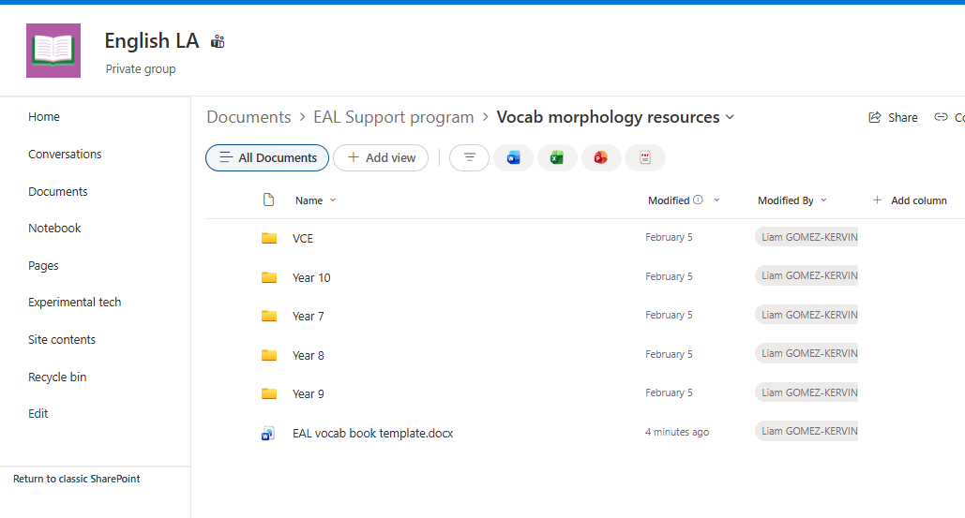

Slide 9
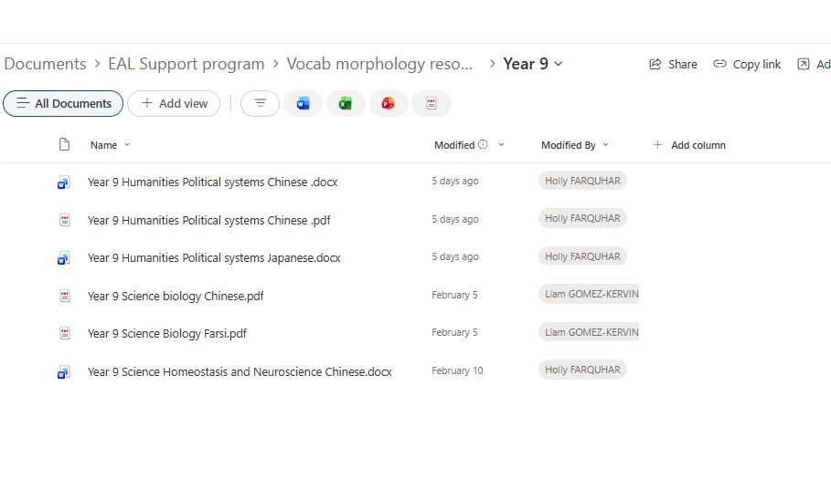

Slide 10
